Slide 1
Course Introduction
DATA STRUCTURES AND ALGORITHMS

Slide 2

Open a file

Slide 3

Look up a contact on your phone

Slide 4

Do a web search

Slide 5
COURSE CODE | CS106P/CS104L
COURSE TITLE | DATA STRUCTURES AND ALGORITHMS
PRE-REQUISITE | IT 101-2
CO-REQUISITE | None
CREDIT UNIT(S) | Three (3) units
CLASS SCHEDULE | 4.5 hours per week

Slide 6
COURSE DESCRIPTION
This course is focused on the study data abstractions, and core set of data structures and algorithms that provide a foundation for writing efficient programs. This course is about showing the correctness of algorithms and studying their computational complexities, a mixture of theoretical knowledge and practical experience.

Slide 7


Analyze the performance and complexity of an algorithm using asymptotic notation to use and manage memory effectively.
COURSE OUTCOME 1

Slide 8
Implement an Abstract Data Type (ADT) program for each of the identified data structure and algorithm principle
COURSE OUTCOME 2

Slide 9
Evaluate the applied appropriate data structures in considering the costs and benefits of solving programming problems.
COURSE OUTCOME 3

Slide 10

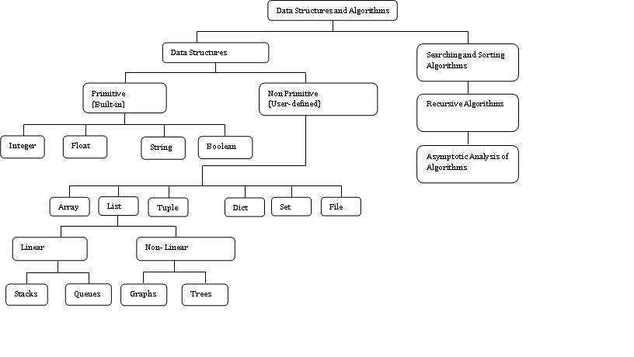

Slide 11
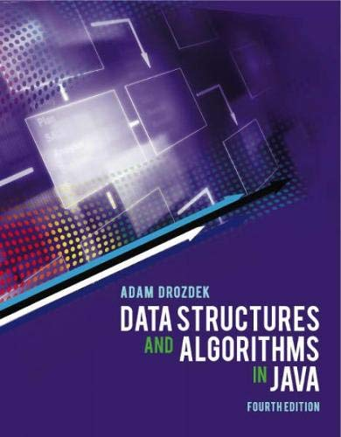
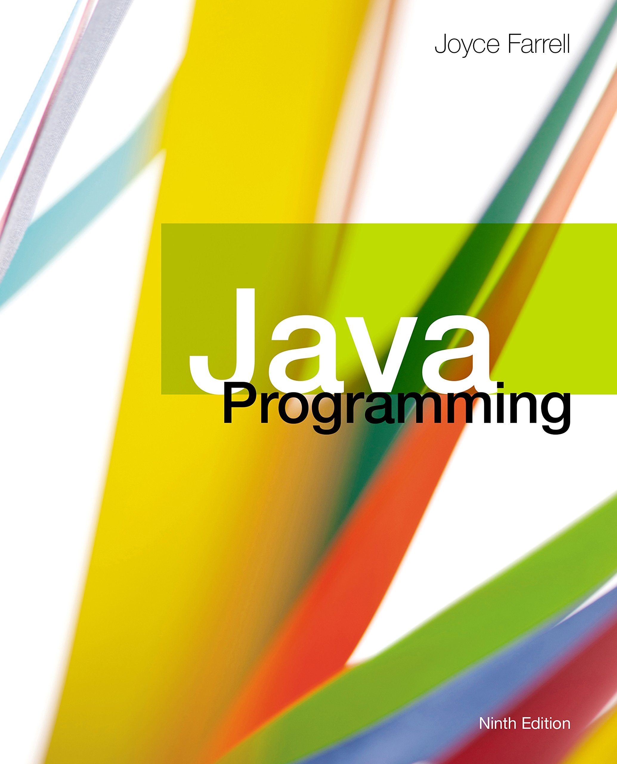
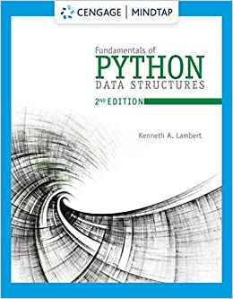
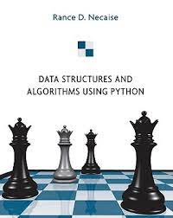

Slide 12
MODULE 1 –Analysis of the Complexity of Algorithms
Week | MEDIATING OUTCOMES | TOPICS
Week 1 | Course Introduction MO11 Explain the importance of Data Structures | MCM Mssion, Vision, Core Values About the Course Policies and Guidelines Differences of ITE Courses Discussion of Project Specification and Rubrics Introduction to Data Structures and Algorithms Types of Data Structures
Week 2 | MO12 Evaluate a program using Asymptotic Notation | Time and Space Complexity Evaluate program efficiency using T(n) Properties and Operations of ADT Create ADT based on real-world scenario/model (WaterTank)
 | MO13 Create ADT in formulating program solutions
Week 3 | MO14 Analyze the performance of different sorting techniques | Different Sorting techniques/algorithm Assess the performance of different sorting techniques Implement ADT to each sorting technique
Week 4 | Assessing Module 1: Preliminary Examination

Slide 13
MODULE 2 – LINEAR STRUCTURES AND LINEAR SEARCH ALGORITHM
Week | MEDIATING OUTCOMES | TOPICS
Week 5 | MO25 Implement ADT to Linear Data Structures/Algorithm using array-based structure | Linear Structures : Stack and Queue Operations of Stack/Queue Stack/Quee ADT Creation (Array Structure Implementation) Application
Week 6 | MO26 Implement ADT to Linear Data Structures/Algorithm using dynamic-based structure | Linear Search and LinkedList Algorithms Operations of LinkedList ADT LinkedList Structure Implementation Stack/Queue ADT Creation Application Types of LinkedList
Week 7 | MO7 Create recursive functions to increase program efficiency | Recursion Recursive function Fibonacci series and factorial
Week 8 | Assessing Module 2: Midterm Examination

Slide 14
MODULE 3 – NON-LINEAR (HIERARCHICAL) DATA STRUCTURES
Week | MEDIATING OUTCOMES | TOPICS
Week 9 | MO27 Build ADTs for Non-linear (hierarchical) data Structures | General Tree and Binary Trees Tree Operations Tree Traversals BT ADT Creation (LinkedList Implementation) Applications
Week 10 |  | Binary Search Trees and Priority Queues BSTree Operations BSTree Traversals BST ADT Creation (LinkedList Implementation) Applications
Week 11 | MO28 Provide an efficient programming solution based on identified problem scenario
Week 12 | Assessing Module 3: Final Examination

Slide 15



Programming Language

Slide 16
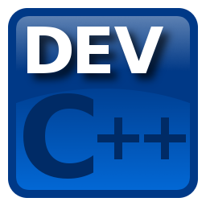





Integrated Development Environment

Slide 17
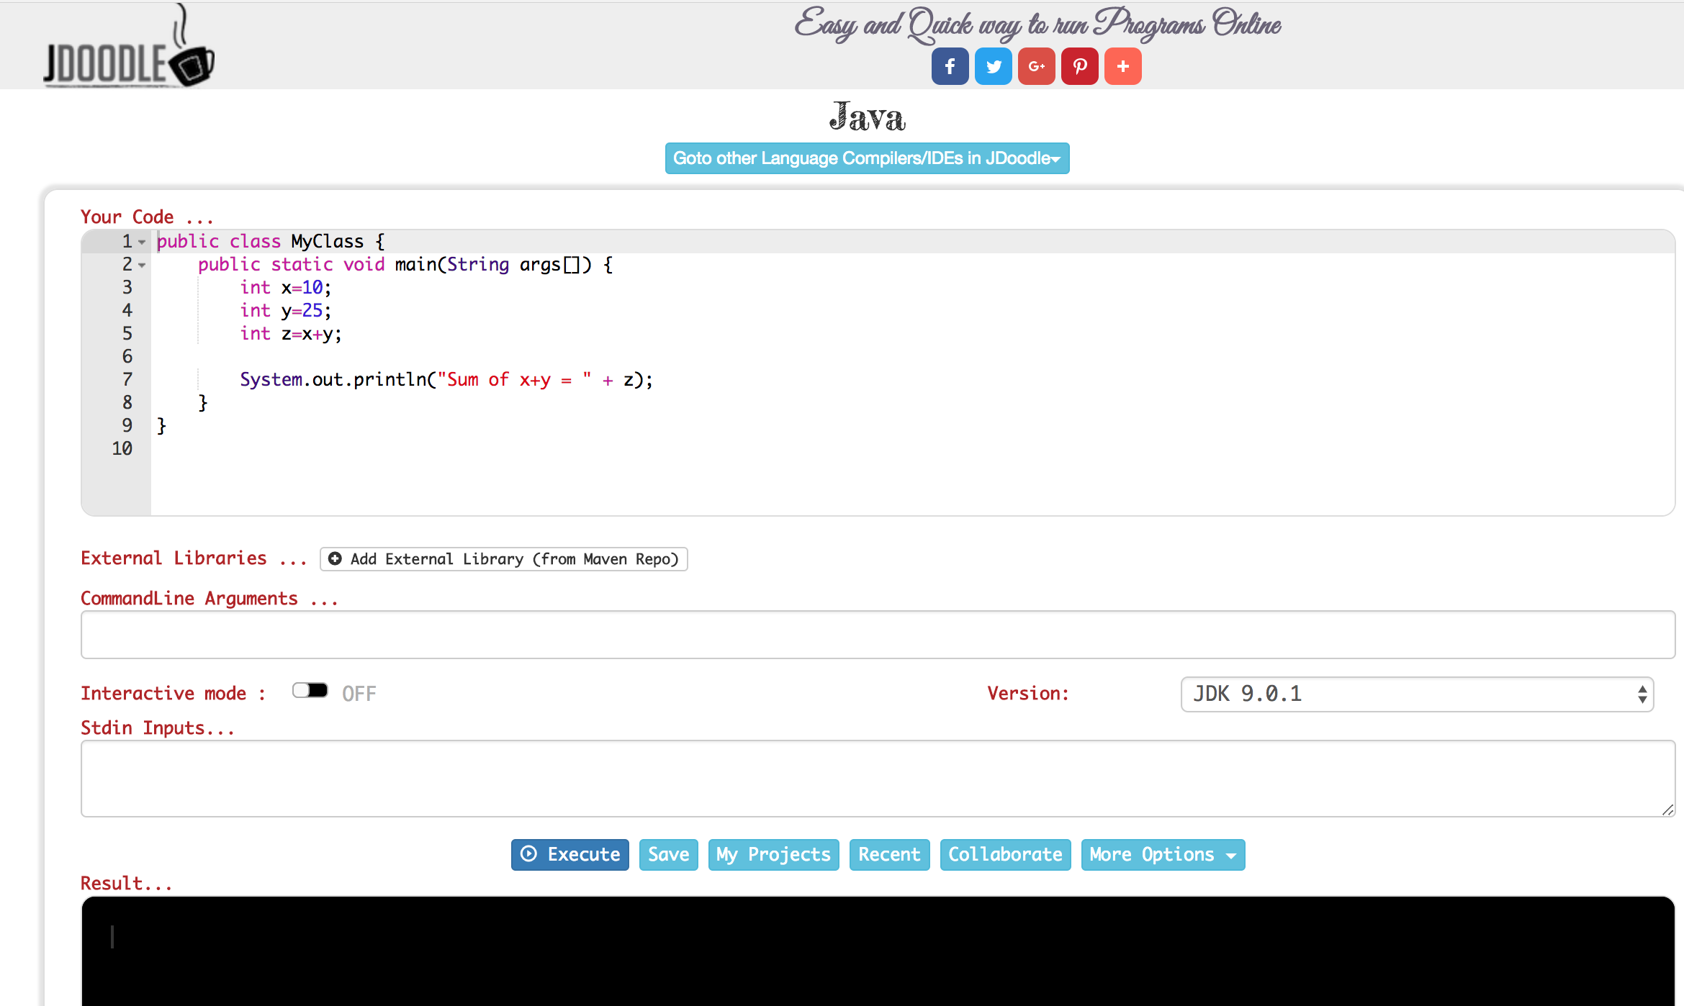
https://www.jdoodle.com/online-java-compiler/
Online Tools

Slide 18
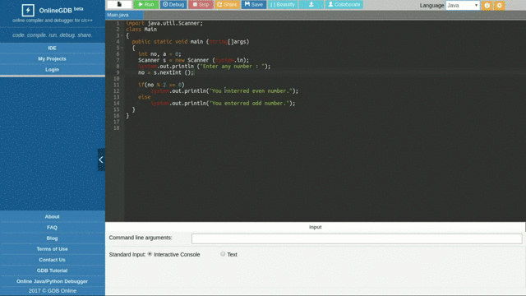
https://www.onlinegdb.com/online_java_compiler
Online Tools

Slide 19
Recommendation

Slide 20
Thank you!
Martzel Baste
CCIS Department

